Slide 1
Chapter 11: Trigonometric Identities
11.1 Trigonometric Identities
11.2 Addition and Subtraction Formulas
11.3 Double-Angle, Half-Angle, and Product-Sum Formulas
11.4 Inverse Trigonometric Functions
11.5 Trigonometric Equations

Slide 2
11.1 Trigonometric Identities
In 1831, Michael Faraday discovers a small electric current when a wire is passed by a magnet.
This phenomenon is known as Faraday’s law. This property is used to produce electricity by rotating thousands of wires near large electromagnets.
Electric generators supply electricity to most homes at a rate of 60 cycles per second.
This rotation causes alternating current in wires and can be modeled by either sine or cosine functions.

Slide 3
11.1 Fundamental Identities
Fundamental Identities
Pythagorean Identities
Even-Odd Identities
Note It will be necessary to recognize alternative forms of the identities
above, such as sin² θ = 1 – cos² θ and cos² θ = 1 – sin² θ.

Slide 4
11.1 Fundamental Identities
Cofunction Identities

Slide 5
11.1 Looking Ahead to Calculus
Work with identities to simplify an expression with the appropriate trigonometric substitutions.
For example, if x = 3 tan θ, then

Slide 6
11.1 Expressing One Function in Terms of Another
Example Express cos x in terms of tan x.
Solution Since sec x is related to both tan x and cos x
by identities, start with tan² x + 1 = sec² x.
Choose + or – sign, depending on the quadrant of x.

Slide 7
11.1 Rewriting an Expression in Terms of Sine and Cosine
Example Write tan θ + cot θ in terms of sin θ and
cos θ.
Solution

Slide 8
11.1 Verifying Identities
Learn the fundamental identities.
Try to rewrite the more complicated side of the equation so that it is identical to the simpler side.
It is often helpful to express all functions in terms of sine and cosine and then simplify the result.
Usually, any factoring or indicated algebraic operations should be performed. For example,
As you select substitutions, keep in mind the side you are not changing, because it represents your goal.
If an expression contains 1 + sin x, multiplying both numerator and denominator by 1 – sin x would give 1 – sin² x, which could be replaced with cos² x.

Slide 9
11.1 Verifying an Identity ( Working with One Side)
Example Verify that the following equation is an identity.
cot x + 1 = csc x(cos x + sin x)
Solution Since the side on the right is more complicated, we work with it.
Original identity
Distributive property
The given equation is an identity because the left side equals the right side.

Slide 10
11.1 Verifying an Identity
Example Verify that the following equation is an identity.
Solution

Slide 11
11.1 Verifying an Identity ( Working with Both Sides)
Example Verify that the following equation is an identity.
Solution

Slide 12
11.1 Verifying an Identity ( Working with Both Sides)
We have shown that

Slide 13
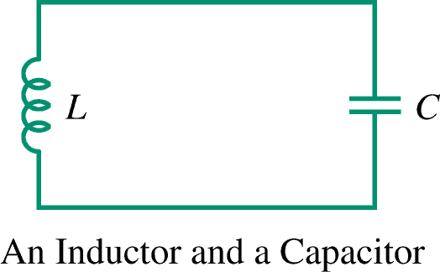
11.1 Applying a Pythagorean Identity to Radios
Example Tuners in radios select a
radio station by adjusting the frequency.
These tuners may contain an inductor L
and a capacitor C. The energy stored
in the inductor at time t is given by:
L(t) = k sin² (2πFt)
and the energy stored in the capacitor is given by
C(t) = k cos² (2πFt),
where F is the frequency of the radio station and k is a constant.
The total energy E in the circuit is given by E(t) = L(t) + C(t).
Show that E is a constant function.

Slide 14
11.1 Applying a Pythagorean Identity to Radios
Solution

